Slide 1



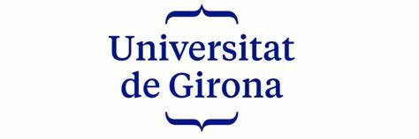
Two-Step Hierarchical Binary Classification of Skin Lesion: A Comparison among Machine and Deep-Transfer Learning Techniques
ISIC 2017 CLASSIFICATION CHALLENGE:
Including CNN, VGG16, ResNet, DenseNet, Random Forest, SVM, K-NN, and Logistic Regression
Presentation by:
Daniel Tweneboah Anyimadu

Slide 2
ABSTRACT
The experiment is conducted on the ISIC 2017 skin lesion classification dataset. The project involves exploratory data analysis, data preprocessing, model training, feature extraction / classification, and performance evaluation.
The models are evaluated based on their overall accuracy and balanced multiclass accuracy (BMA) values on a test dataset.
The DenseNet and DenseNet + Random Forest models achieved BMA of 0.975 and 0.921 respectively on the test dataset. The findings reveal the effectiveness of the two-step hierarchical approach in improving binary classification despite class imbalance and lesion variability.
This study addresses skin lesion classification challenges comparing various machine and deep learning techniques, enhancing accuracy despite class imbalance and lesion variability.
A two-step hierarchical binary classification framework is proposed with the aim of distinguishing between benign and malignant lesions, and further identifying malignant lesions as seborrheic keratosis or melanoma.
2

Slide 3
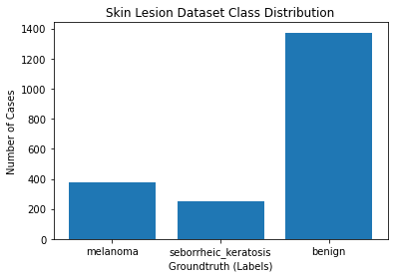
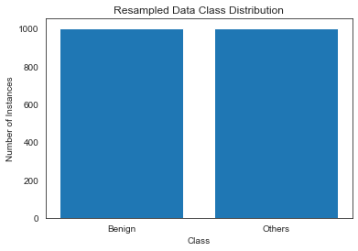
Exploratory Data Analysis (EDA) & Preprocessing
Class Distribution Plot :
Resampling Plot :
A visualization of class imbalance shown in the class distribution plot.
Cases of Melanoma and Seborrheic keratosis were combined to create a malignant group. Resampling techniques, including upsampling and downsampling were employed to address class imbalance as depicted in the resampling plot.
3

Slide 4
Train-Test Split, Feature Scaling & Feature Transformation
Train-Test Split:
Performed train-test split by creating subsets of the resampled data.
The data was divided class-wise into a fixed split of 70% for training and 30% for validation.
There was no random splitting to ensure consistency among different groups.
Feature Scaling:
The extracted features from the deep learning models are normalized using standardization techniques for both training and test data. To ensure similar feature distribution, this technique transforms the features to have a mean of 0 and a standard deviation of 1.
Feature Selection:
Principal Component Analysis (PCA) is applied to reduce dimensionality by selecting the top 50 and 70 components. This is done to reduce noise and multicollinearity.
4

Slide 5
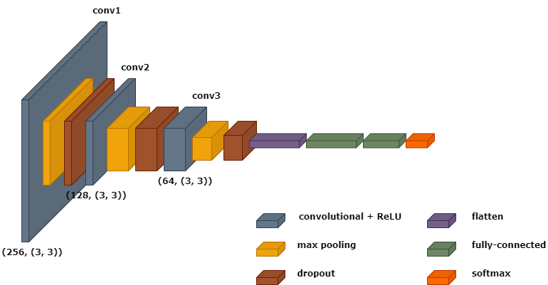
Deep Learning (Model Training)
DenseNet
DenseNet stands out for its densely connected layers, promoting feature reuse and flow of information between layers.
VGG16:
Its deep architecture aids in capturing hierarchical features, contributing to accurate classification.
ResNet:
Excels in mitigating the vanishing gradient problem. Its residual connections allow for the training of very deep networks, making it a robust choice for skin lesion feature extraction.
Convolutional Neural Network Architecture:
This is designed to automatically learn and extract skin lesion features for classification task.
5

Slide 6
Machine Learning (Model Training)
Machine Learning Models:
A subfield of AI which involves developing models to analyze massive datasets and extract meaning patterns and insights for automatically making predictions.
Random Forest (Ensemble model):
This model leverages decision trees to provide robust predictions.
Support Vector Machine ():
SVM excels in finding optimal hyperplanes to separate different classes effectively.
K-NN (Non-Parametric model):
K-NN relies on proximity to neighbors for classifying skin lesion images.
Logistic Regression ():
It models the probability of a skin lesion feature belonging to a particular class.
6

Slide 7
PERFORMANCE EVALUATION (BMA & ACCURACY)
MODEL (DL) | 5-FOLD CROSS (VALIDATION) | MODEL (ML) | 5-FOLD CROSS (VALIDATION)
DenseNet | 0.870, 0.974 | Random Forest + DenseNet | 0.829, 0.911
CNN | 0.925, 0.917 | Random Forest + CNN | 0.814, 0.889
VGG16 | 0.892, 0.973 | Random Forest + VGG16 | 0.808, 0.887
ResNet | 0.661, 0.781 | Random Forest + ResNet | 0.813, 0.886
MODEL (DL) | ACCURACY | BMA (TEST)
DenseNet | 0.797, 0.977 | 0.792, 0.975
CNN | 0.792, 0.907 | 0.787, 0.904
VGG16 | 0.797, 0.91 | 0.793, 0.911
ResNet | 0.627, 0.73 | 0.640, 0.746
MODEL (ML) | ACCURACY | BMA (TEST)
Random Forest + DenseNet | 0.847, 0.93 | 0.848, 0.921
Random Forest + CNN | 0.832, 0.903 | 0.834, 0.895
Random Forest + VGG16 | 0.823, 0.903 | 0.823, 0.895
Random Forest + ResNet | 0.84, 0.89 | 0.840, 0.881
7

